Slide 1
Use of non-burning technologies in HCWM, and injection safety practices among hospital staff and waste workers
Mahesh NAKARMI
Senior Health Care Waste Management Specialist / HECAF

Slide 2
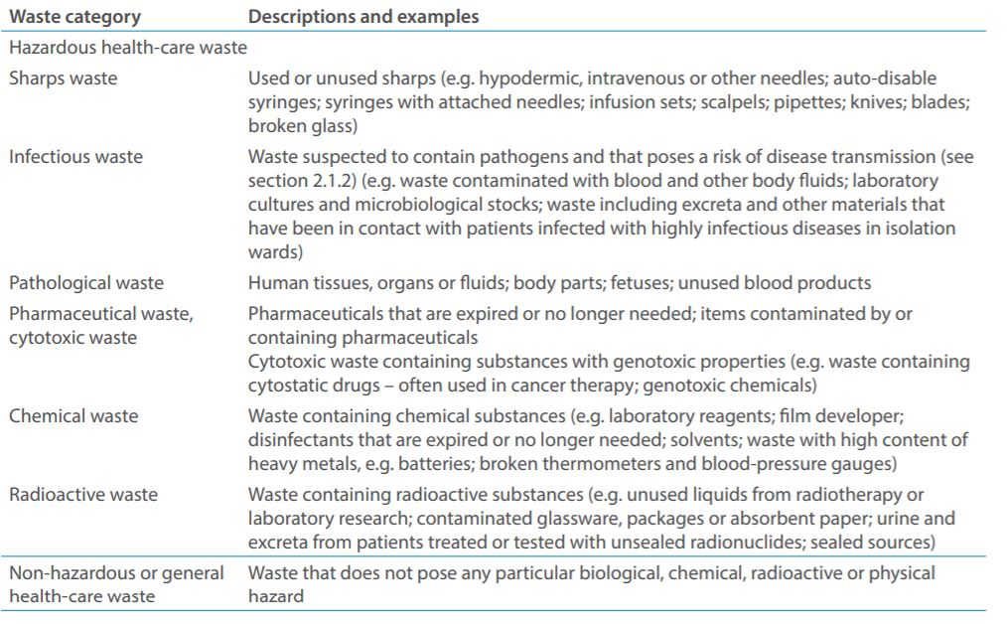
WHO - Categories of HCW

Slide 3
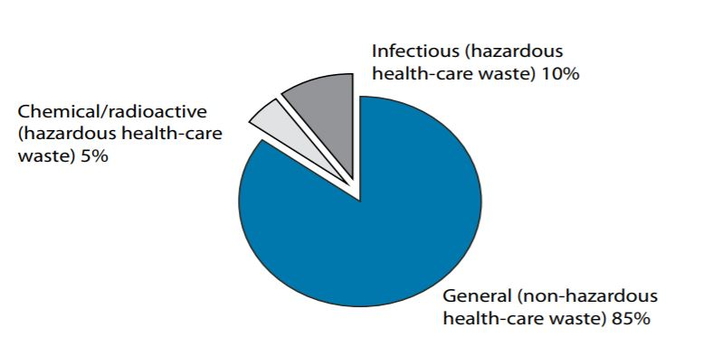
WHO - Waste Composition

Slide 4
Human Health vs. Environment
Human health is directly impacted by the environment
  Climate change
  Air pollution
  Contaminated water
  Toxic chemicals
  Bad waste management

Slide 5
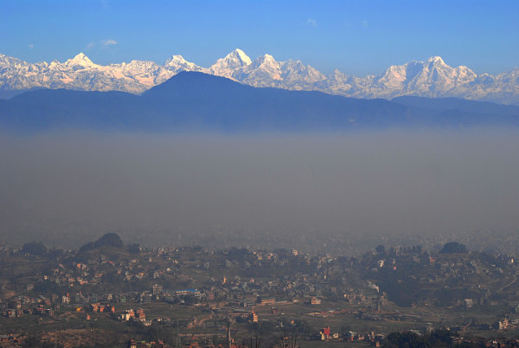
Pollution affects us all
Photo credit: http://twicsy.com/i/fTCj6
Globally, 23% of deaths are linked to the environment (WHO 2016)
Air pollution causes 7 million excess deaths (Lancet 2012)
Notes:
Globally, almost one quarter of the deaths (23%) are linked to the environment. This amounts to 3.8 million in the SEARO region (Preventing disease through healthy environments, April 2016, http://who.int/quantifying_ehimpacts/publications/preventing-disease/en/).
According to the WHO Country Cooperation Strategy for Nepal, water, sanitation and hygiene associated diseases including skin diseases, acute respiratory infections (ARI) and diarrheal diseases are the three leading preventable diseases. The latter two are among leading causes of child deaths.

Slide 6
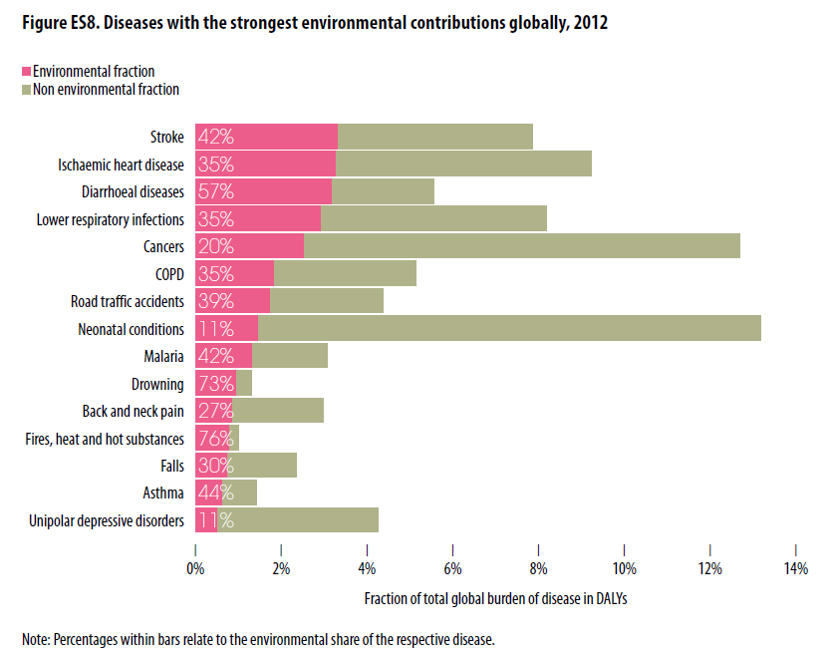
Environmental contributions to global diseases 2012
WHO (2016) Preventing disease through healthy environments: a global assessment of the burden of disease from environmental risks

Slide 7
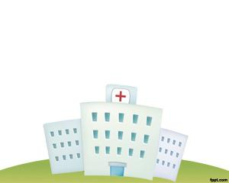

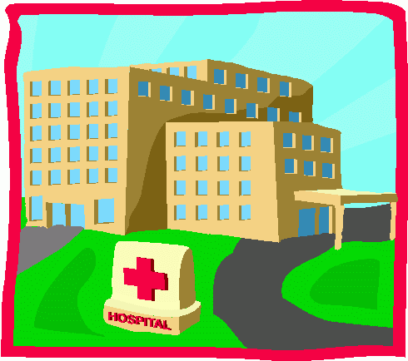
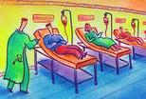


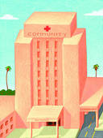


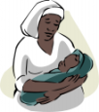
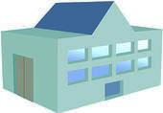
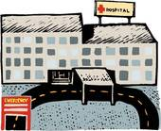


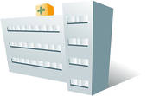
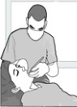

TECHNOLOGY is key in Treatment Process
Treatment Approaches
On-site – healthcare facility treats its own waste
T
On-Site Treatment
Cluster/Hub treatment – hospital treats its waste plus waste from other health facilities in a small area
T
Cluster/Hub Treatment
Central treatment – dedicated treatment plant collects and treats wastes from many health facilities in an urban center or region
T
Central Treatment
T
T
Notes:
There is a fourth treatment approach: mobile treatment. In mobile treatment, the treatment technology is mounted on a vehicle which then goes from hospital to hospital to treat the waste. This is used in some countries mainly with autoclave-type treatment.

Slide 8
Factors in the selection of treatment methods
Types and quantities of waste for treatment and disposal
Capability of the healthcare facility to handle the waste quantity
Technological capabilities and requirements
Availability of treatment options and technologies
Capacity of system
Treatment efficiency (microbial inactivation efficacy)
Occupational health and safety factors
Environmental releases
Volume and/or mass reduction
Installation requirements
Space available for equipment
Notes:
There are many factors to consider when deciding upon a treatment method

Slide 9
Factors in the selection of treatment methods
Operation and maintenance requirements
Infrastructure requirements
Skills needed for operating the technology
Location and surroundings of the treatment and disposal sites
Options available for final disposal
Public acceptability
Regulatory requirements
Capital cost of the equipment
Operating and maintenance costs of the equipment
Other costs including costs of shipping, customs duties, installation and commissioning, transport and disposal of residues, and decommissioning

Slide 10

International guidance on waste treatment technologies
World Health Organisation
2004 policy: scale up steam-based treatment
Blue Book Second edition, in press: priority for non-incineration
Stockholm Convention:
waste incinerators are specifically identified as potential sources of highly toxic dioxins and furans.
guidelines on medical waste states that “priority consideration should be given to alternative processes” that do not generate dioxins and furans
Basel Convention:
2003 Guidance: prefer steam based treatment

Slide 11
Healthcare waste treatment process
Five basic processes are used for the treatment of hazardous healthcare wastes, particularly sharps, infectious and pathological waste:
  Thermal
  Chemical
  Irradiation
  Biological
  Mechanical (used to supplement the other processes)

Slide 12
Thermal Treatment Processes
Rely on heat to destroy pathogens
Divided into two types:
  High-heat thermal systems
  which involve combustion and/or pyrolysis of healthcare waste
  Low-heat thermal systems
  also called non-burn or non-incineration treatment technologies
Notes:
Pyrolysis: thermal degradation of a substance through the application of heat in the absence of oxygen

Slide 13
European definition of incineration
‘incineration plant’ means any stationary or mobile technical unit and equipment dedicated to the thermal treatment of wastes with or without recovery of the combustion heat generated. This includes the incineration by oxidation of waste as well as other thermal treatment processes such as pyrolysis, gasification or plasma processes in so far as the substances resulting from the treatment are subsequently incinerated.
DIRECTIVE 2000/76/EC OF THE EUROPEAN PARLIAMENT
AND OF THE COUNCIL of 4 December 2000
on the incineration of waste

Slide 14
Types of Incinerators
Rotary kiln
Fixed hearth
Liquid injection
Cement and lime kilns
Fluidized bed
Boiler systems
Oxygen enriched
Infrared
Fume
Multiple chamber
Multiple hearth
Cyclonic
Auger combustor
Two-stage (starved air)
Catalytic
Molten salt

Slide 15
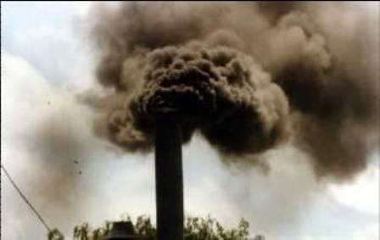
Problems of incineration
Emissions of dioxins, furans, other toxics
High carbon footprint (CO₂ and water vapour)
Waste of resources
Very high cost (millions of dollars to meet international standards)
Cleanest when continuously operated- disincentive for waste reduction
Water vapour
CO₂

Slide 16
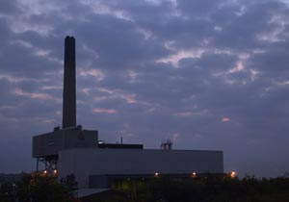
In 1995, garbage incinerators and medical waste incinerators were two of the largest sources of dioxin identified by the U.S. Environmental Protection Agency,¹ and medical waste incinerators alone were responsible for 10% of the mercury emissions into the environment according to a US EPA report.

Slide 17

Decline in Construction of New Medical Waste Incinerators in the U.S.
EPA original projection of new medical waste incinerators (without the HMIWI rule) vs. Actual Number of new medical waste incinerators built since the HMIWI rule, as of 2008
Notes:
If EPA did not promulgate its 1997 HMIWI (hospital/medical/infectious waste incinerator) rule, 700 new incinerators would have been constructed in the second half of the 1990s based on existing trends. Because of the HMIWI rule, as of 2008, only five new incinerators were actually constructed since the rule was proposed in 199. Source: New Source Projections for HMIWI Population, T. Holloway, EPA Background Information Document, June 30, 2008.

Slide 18
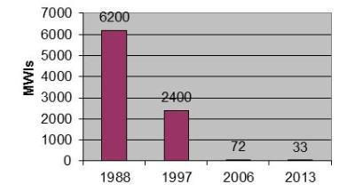
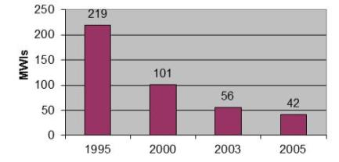
Closure of Medical Waste Incinerators in Developed Countries
United States
Canada
Germany
Portugal
Ireland
Slide courtesy of Dr Jorge Emmanuel
Notes:
Good waste minimisation and recycling strategies can address a lot of the waste, but inevitably there will be those infectious or otherwise hazardous streams that have to be disposed of. In the past it was normal for healthcare facilities to have incinerators, but this practice has been in decline for the last twenty to thirty years, as you can see on this slide from our friend and colleague Dr Jorge Emmanuel. This change has been driven both by the need to reduce dioxin emissions from incinerators and the introduction of non-incineration waste treatment technologies.

Slide 19
Incineration costs too much for USA
Based on the stringency of the HMIWI standards promulgated on October 6, 2009, sources would likely respond to the HMIWI rule by choosing not to construct new HMIWI and would use alternative waste disposal options rather than incur the costs of compliance.
US Environmental Protection Agency Standards of Performance for
New Stationary Sources and Emissions Guidelines for Existing Sources: Hospital/Medical/Infectious Waste Incinerators. Federal Register
Vol. 76, No. 64 April 4, 2011, Rules and Regulations, pp 18407-18415

Slide 20
Examples of Treatment Technologies
That Do Not Generate Dioxins/Furans
Non-Burn Thermal Technologies
  Autoclaves
  Hybrid Steam Systems
  Microwave Units
  Frictional Heat Treatment
  Dry Heat Systems
Chemical Technologies
  Alkaline Hydrolysis

Slide 21
Autoclaves
Capable of treating a wide range of healthcare wastes
Consists of a metal vessel designed to withstand high pressures, with a sealed door and an arrangement of pipes and valves through which steam is brought in and removed
Removal of air from the vessel is essential to ensure penetration of heat into the waste
The air that is removed must be treated to prevent the release of pathogenic aerosols, usually done with a high-efficiency particulate air (HEPA) filter or steam
Notes:
Low-heat thermal processes such as autoclaves produce substantially less air pollution than high-heat thermal process.
Autoclaves are not generally used for large anatomical remains (body parts).

Slide 22
Autoclaves
Autoclaves generate significantly less air pollutants than incinerators and other high-heat thermal processes.
Volatile and semi-volatile organic compounds, cytotoxic waste, mercury, other hazardous chemical waste, and radioactive waste should not be treated in an autoclave
Odors can cause problems around autoclaves if there is insufficient ventilation
Waste streams need to be properly segregated in order to prevent hazardous chemicals from being placed in the treatment chamber
  Poorly segregated waste may emit low levels of alcohols, phenols, formaldehyde, and other organic compounds in the air and pose health risks to the autoclave operators and waste workers
Treated waste from an autoclave will retain its physical appearance; shredding (though prone to break downs) may reduce the volume 60-80%

Slide 23
Types of Waste Treatment Autoclaves
Classification based on configuration
  Horizontal
  Vertical
Classification based on how air is removed
  Gravity displacement
  Pre-vacuum
  Pre- and post-vacuum
  Pressure pulsing including multiple vacuum autoclaves
Notes:
Waste is introduced at the top of a vertical autoclave. Waste is placed in horizontally in a horizontal autoclave.
A gravity-displacement autoclave takes advantage of the fact that steam is lighter than air. Hence, steam is introduced under pressure into the chamber, forcing the air downward into an outlet port at the bottom of the chamber.
A more effective, but costlier, method is the use of a vacuum pump and/or a steam ejector to evacuate air before introducing steam, as is done in pre-vacuum (also called high vacuum) autoclaves. Pre-vacuum autoclaves need less time for disinfection due to their greater efficiency in removing air and disinfecting waste.
Other autoclaves use pressure pulsing to evacuate air. The three basic types of pressure pulsing systems are: pressure gravity, vacuum pulsing and pressure-vacuum. Pressure gravity (or steam flushing) entails repeatedly releasing steam and reducing the pressure to near atmospheric after the pressure has reached a pre-determined level and then allowing the pressure to build up again with the addition of steam. Vacuum pulsing is similar to a high vacuum operation except that two or more vacuum cycles are used at the start of the treatment process. Pressure-vacuum systems operate by building pressure then pulling a vacuum and repeating this process several times during treatment. Alternating pressure cycles are used to achieve rapid penetration of steam. In general, the pressure-vacuum systems have the shortest time for achieving high disinfection levels.

Slide 24
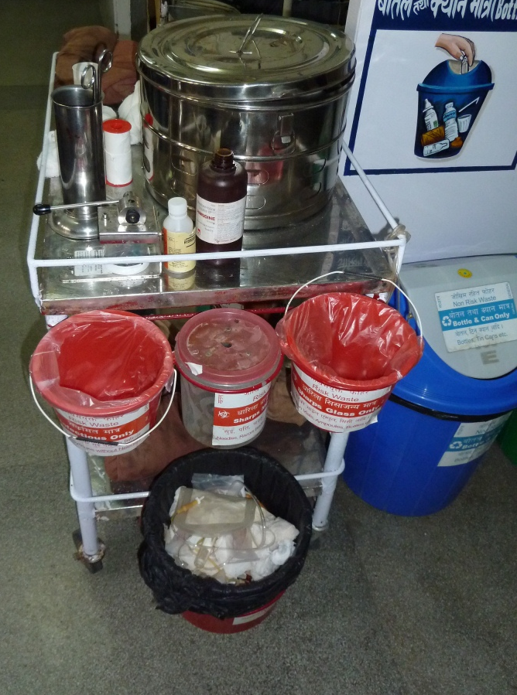
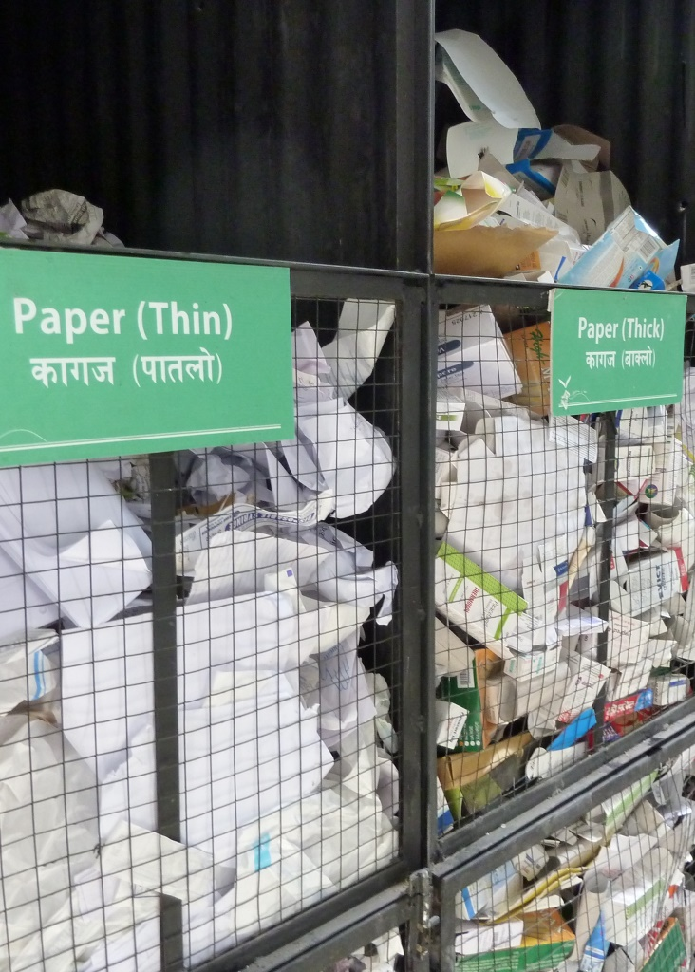
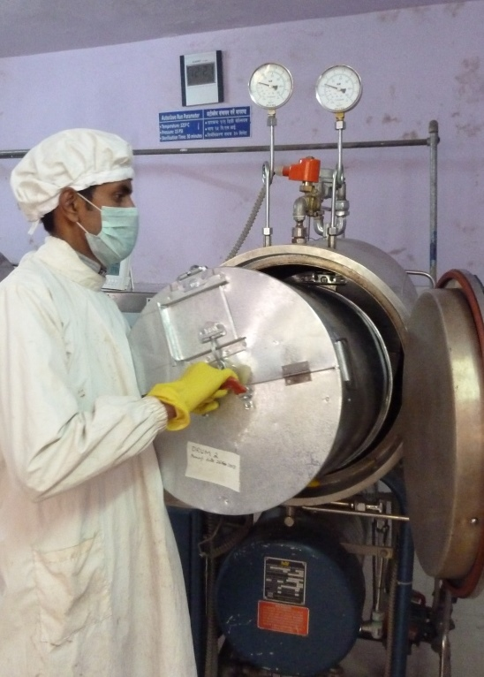
Waste segregation, Autoclaving, Recycling,

Slide 25
Advantages of autoclaves
Eliminates risk from infectious waste
Familiar, easy to maintain
Models for almost every situation- including biomass based one
Easy to monitor and validate
Long lifespan
Cheaper than incineration with air pollution control
Less electricity than many expect
Low carbon footprint
Significantly reduce air pollution- eliminate dioxin emissions
Cleaner and more pleasant environment
Resources saved by recycling
Hub system can handle extra waste during an emergency
Even used for polio vaccine disposal

Slide 26
Carbon footprint- burn vs autoclaving
Note- Nepal mostly generates its power from hydroelectric sources, so the carbon footprint of grid electricity is very low in comparison to most countries. Zimbabwe is more typical for a low income country
Notes:
A typical load requires 10kwH to process

Slide 27
Resource and cost recovery from recycling
Notes:
Bir 2068

Slide 28
Autoclaving is cheaper than incineration

Slide 29
Biological Treatment Process
Specifically refers to the degradation of organic matter through processes occurring in nature
Examples include composting, vermiculture, biodigestion, and natural decomposition through burial of cadavers, tissues and anatomical parts
Some technologies add enzymes to speed up decomposition of organic waste
Composting and vermiculture have been successfully used for placenta and hospital kitchen waste
Notes:
Vermiculture: digestion of organic wastes through the actions of worms

Slide 30
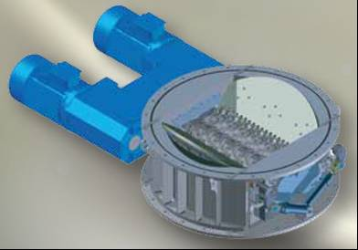
Internal Shredding of Waste
Shredding before disinfection can only be done in a closed system to avoid releasing any pathogens into the air
Shredding is used for the following reasons:
  To increase surface area of contact between waste and disinfectant eliminating voids in the waste load
  To render any anatomical parts unrecognizable to avoid adverse visual impact on disposal
  To reduce the volume of waste (shredding plus compacting before disinfection can reduce original waste amount 60-90%, depending upon equipment used)
Removable internal shredder
Source: Metan
Notes:
Image source: Metan
The image is of a typical cassette-type shredder used as internal shredders. When ever the shredder has to be replaced or cleaned, the shredder is easily removed much like a cassette.

Slide 31
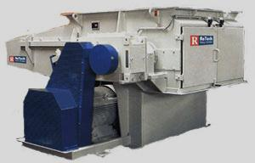
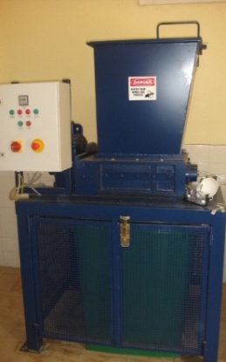

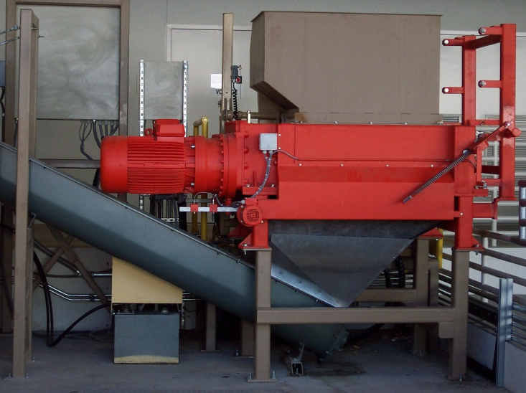
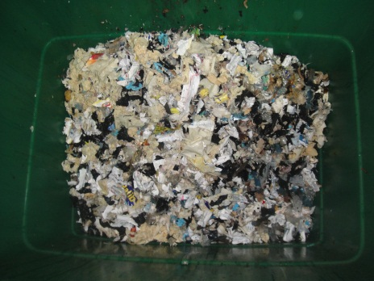
Post-Treatment Shredders Designed for Healthcare Waste
Source: Mercodor, Mark Costello/Vecoplan, Aduromed
Notes:
Left photo is a Mercodor medical waste shredder from Germany.
Middle top photo shows the cutter disks of the Mercodor, and middle bottom photo shows results of shredding of sterilized hospital waste.
Right top photo: Vecoplan medical waste shredder (Germany).
Bottom right photo: Aduromed AVR 50 shredder with auger
Note to UIC: left and center bottom photos are mine; center top photo from Mercodor, right photo from Mark Costello website

Slide 32
Autoclaving delivers cleaner air
Pollutant | Reductions achieved through meeting MACT# (lb/yr)* | Reductions achieved through alternative disposal (lb/yr)* | Advantage alternatives- how many times more effective they are at reducing pollution**
HCl | 168,000 | 198,000 | 1.18
CO | 1,140 | 20,200 | 17.7
Pb | 313 | 420 | 1.34
Cd | 15.6 | 35.1 | 2.25
Hg | 605 | 682 | 1.13
PM | 3,170 | 89,900 | 28.4
CDD/CDF, total | 0.0678 | 0.0985 | 1.45
CDD/CDF, TEQ | 0.00145 | 0.00183 | 1.26
NOX | 146,000 | 1,080,000 | 7.40
SO2 | 73,700 | 126,000 | 1.71
Total | 393,000 | 1,520,000 | 3.87
*USEPA Standards of Performance for New Stationary Sources and Emissions Guidelines for Existing Sources: Hospital/Medical/Infectious Waste Incinerators; Final Rule. Federal Register Vol. 74, No. 192, October 6, 2009 ,
Rules and Regulations, pp 51368 – 51415
**Calculated from data in previous columns
# MACT= maximum achievable control technology

Slide 33
Microwave Treatment
Technologies
Disinfection by moist heat and steam generated by microwave energy
Magnetrons (microwave generators) convert electrical energy into microwave energy
Some systems use temperatures around 97-100ºC with long exposure times. In other systems, steam under pressure is used to achieve temperatures as high as 140ºC.
Notes:
Microwave treatment is essentially a steam-based process since treatment occurs through the action of moist heat and steam generated by microwave energy. Water contained in the waste is rapidly heated by microwave energy at a frequency of about 2450 MHz and a wavelength of 12.24 cm. In general, microwave treatment systems consist of a treatment area or chamber into which microwave energy is directed from a microwave generator (magnetron).
Wastes commonly treated in microwave systems are the same as those treated in autoclaves, such as materials contaminated with blood and body fluids, sharps, and laboratory wastes.

Slide 34
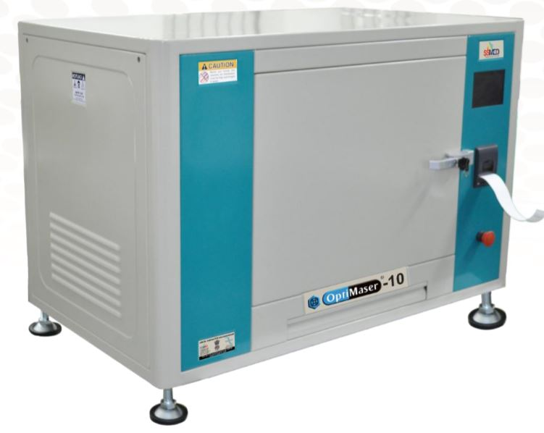
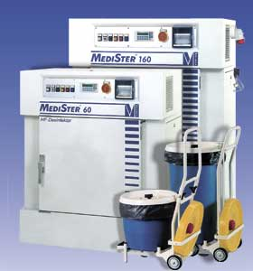
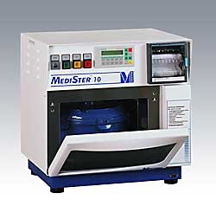
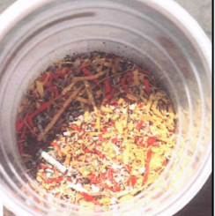
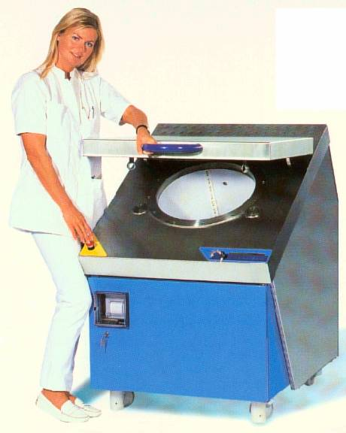
Example of Small to Medium Microwave Systems
Microwave units used in Austria, Bulgaria, Czech Republic, Ecuador, Ethiopia, France, Germany, Greece, Hungary, India, Indonesia, Iran, Kuwait, Latvia, Lithuania, Malaysia, Nigeria, Poland, Romania, Serbia, Turkmenistan, UK and other countries
Sources: Sintion, Meteka, Sterifant
Notes:
A typical batch microwave system, as shown in Figure 11.7, is designed to handle between 30 to 100 liters of waste. Some units require reusable, fully enclosed, microwavable containers. The systems may have multiple programmable cycles corresponding to different treatment temperatures or levels of disinfection. A cycle may range from 30 minutes to one hour.
Photos from top going clockwise: Meteka Medister 10 (8 liter capacity), Meteka Medister 60 and 360 (30 and 60 liter capacities, respectively), Sintion (103 liter capacity), and Sterifant which uses 10-liter containers. Metaka and Sintion are Austrian manufacturers. Sterifant is from Luxembourg.

Slide 35
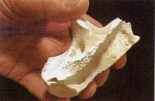
Alkaline Hydrolysis Technologies
Also called tissue digesters
Used for anatomical waste (body parts), organs, tissues, placenta, contaminated animal waste, and cadavers; also destroys formaldehyde and some cytotoxic waste
Process involves placing waste in stainless steel vessels and treatment with steam and alkali (sodium or potassium hydroxide)
The main solid residue remaining from
high pressure alkaline hydrolysis is
calcium
Source: WR2

Slide 36
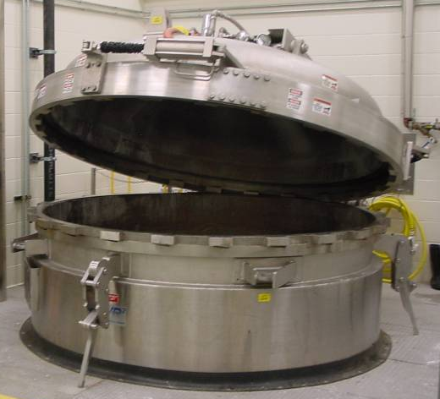
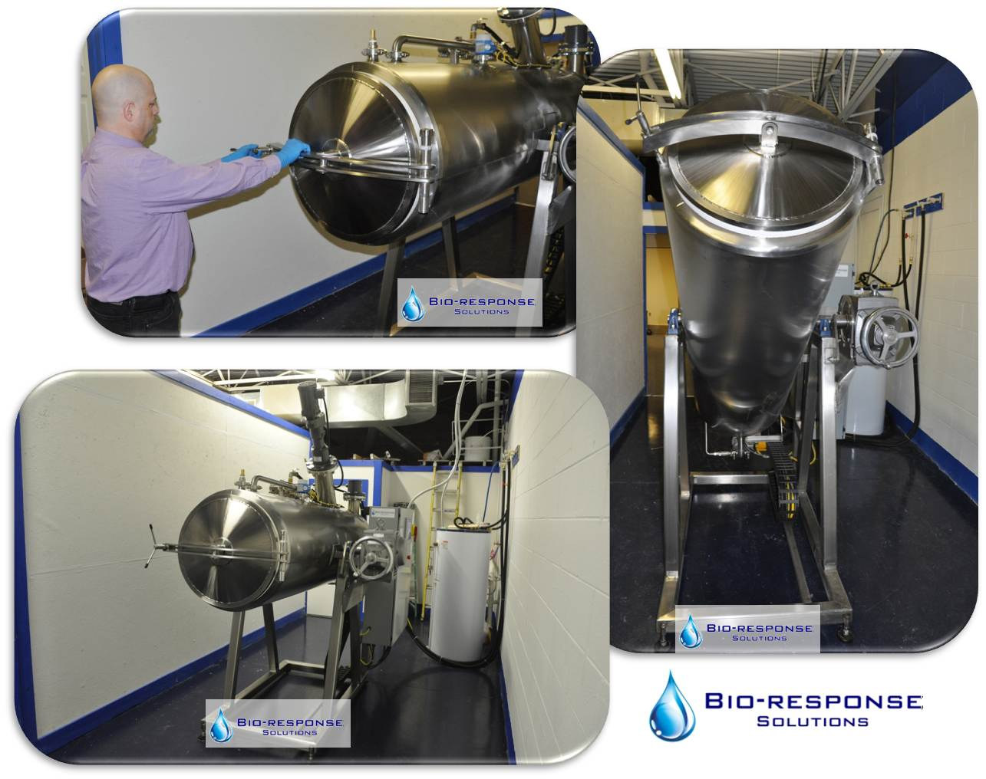
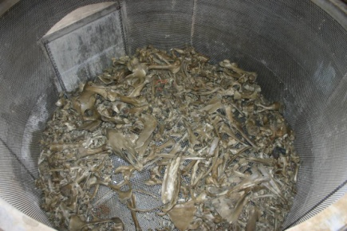
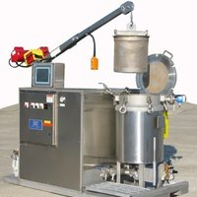
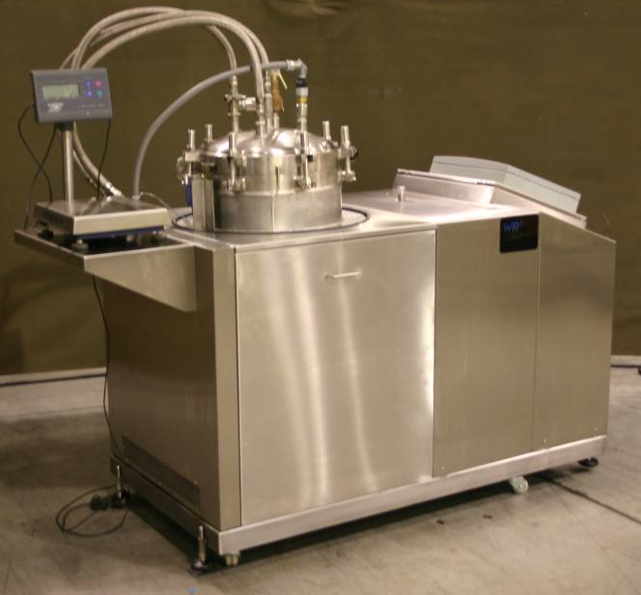
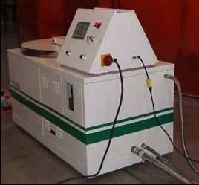
Examples of Alkaline Hydrolysis Systems
Typical residues from alkaline hydrolysis
4500 kg units
21 kg units
Sources: WR2, BioSafe Engineering, PRI, Bio-Response, Peerless
Notes:
Sources: WR2 (top left), BioSafe Engineering (bottom left and top middle), PRI (middle bottom), Bio-Response Solutions (top right), Peerless (bottom right)
Alkaline hydrolysis or alkaline digestion is a process that converts animal carcasses, human body parts and tissues into a decontaminated aqueous solution. The alkali also destroys fixatives in tissues and various hazardous chemicals including formaldehyde, glutaraldehyde and chemotherapeutic agents. The technology uses a steam-jacketed, stainless steel tank and a basket. After the waste is loaded in the basket and into the hermetically sealed tank, alkali (sodium or potassium hydroxide) in amounts proportional to the quantity of tissue in the tank is added along with water. The contents are heated to between 110° to 127°C or higher while being stirred. Depending on the amount of alkali and temperature used, digestion times range from six to eight hours. Low-pressure alkaline digestion units are also available. They generally have longer operating times.
The technology is designed for tissue wastes including anatomical parts, organs, placenta, blood, body fluids, specimens, human cadavers and animal carcasses. The process has been shown to destroy prion waste. The byproducts of the alkaline digestion process are biodegradable mineral constituents of bones and teeth (which can be crushed and recovered as sterile bone meal) and an aqueous solution of peptide chains, amino acids, sugars, soaps, and salts. An excess of hydroxide could lead to a high pH of the liquid waste. Alkaline hydrolysis units have been designed to treat from 10 kg to 4500 kg per batch. The technology has been approved for the destruction of prion waste when treated for at least six hours.

Slide 37
Encapsulation of Healthcare Waste in Low-Resource Settings
Process whereby waste containers are filled, an immobilizing agent is added, and the containers are sealed
Boxes made of high-density polypropylene or metal drums can be 3/4th filled with sharps, or chemical or pharmaceutical residues and immobilizing material (e.g., plastic foam, bituminous sand, cement mortar, or clay) is added and the box is sealed and buried
Notes:
It is not recommended to dispose of untreated HCW in municipal landfills, but if no other option exists for the facility, encapsulation may be an option
Primary advantage of this process is that it reduces the risk of scavengers gaining access to the wastes

Slide 38
Inertization of Healthcare Waste in Low-Resource Settings
Process in which waste is mixed with cement and other substances before disposal so as to minimize the risk of leaching into nearby surface water and groundwater
Especially suitable for pharmaceuticals and incineration ash with high metal content
Process is inexpensive and does not require sophisticated mixing equipment
Notes:
For the inertization of pharmaceuticals, the packaging should be removed, the pharmaceuticals ground up, and a mixture of lime, water, and cement added
The proportions of the mixture by weight are typically as follows:
65% pharmaceutical waste
15% lime
15% cement
5% water

Slide 39
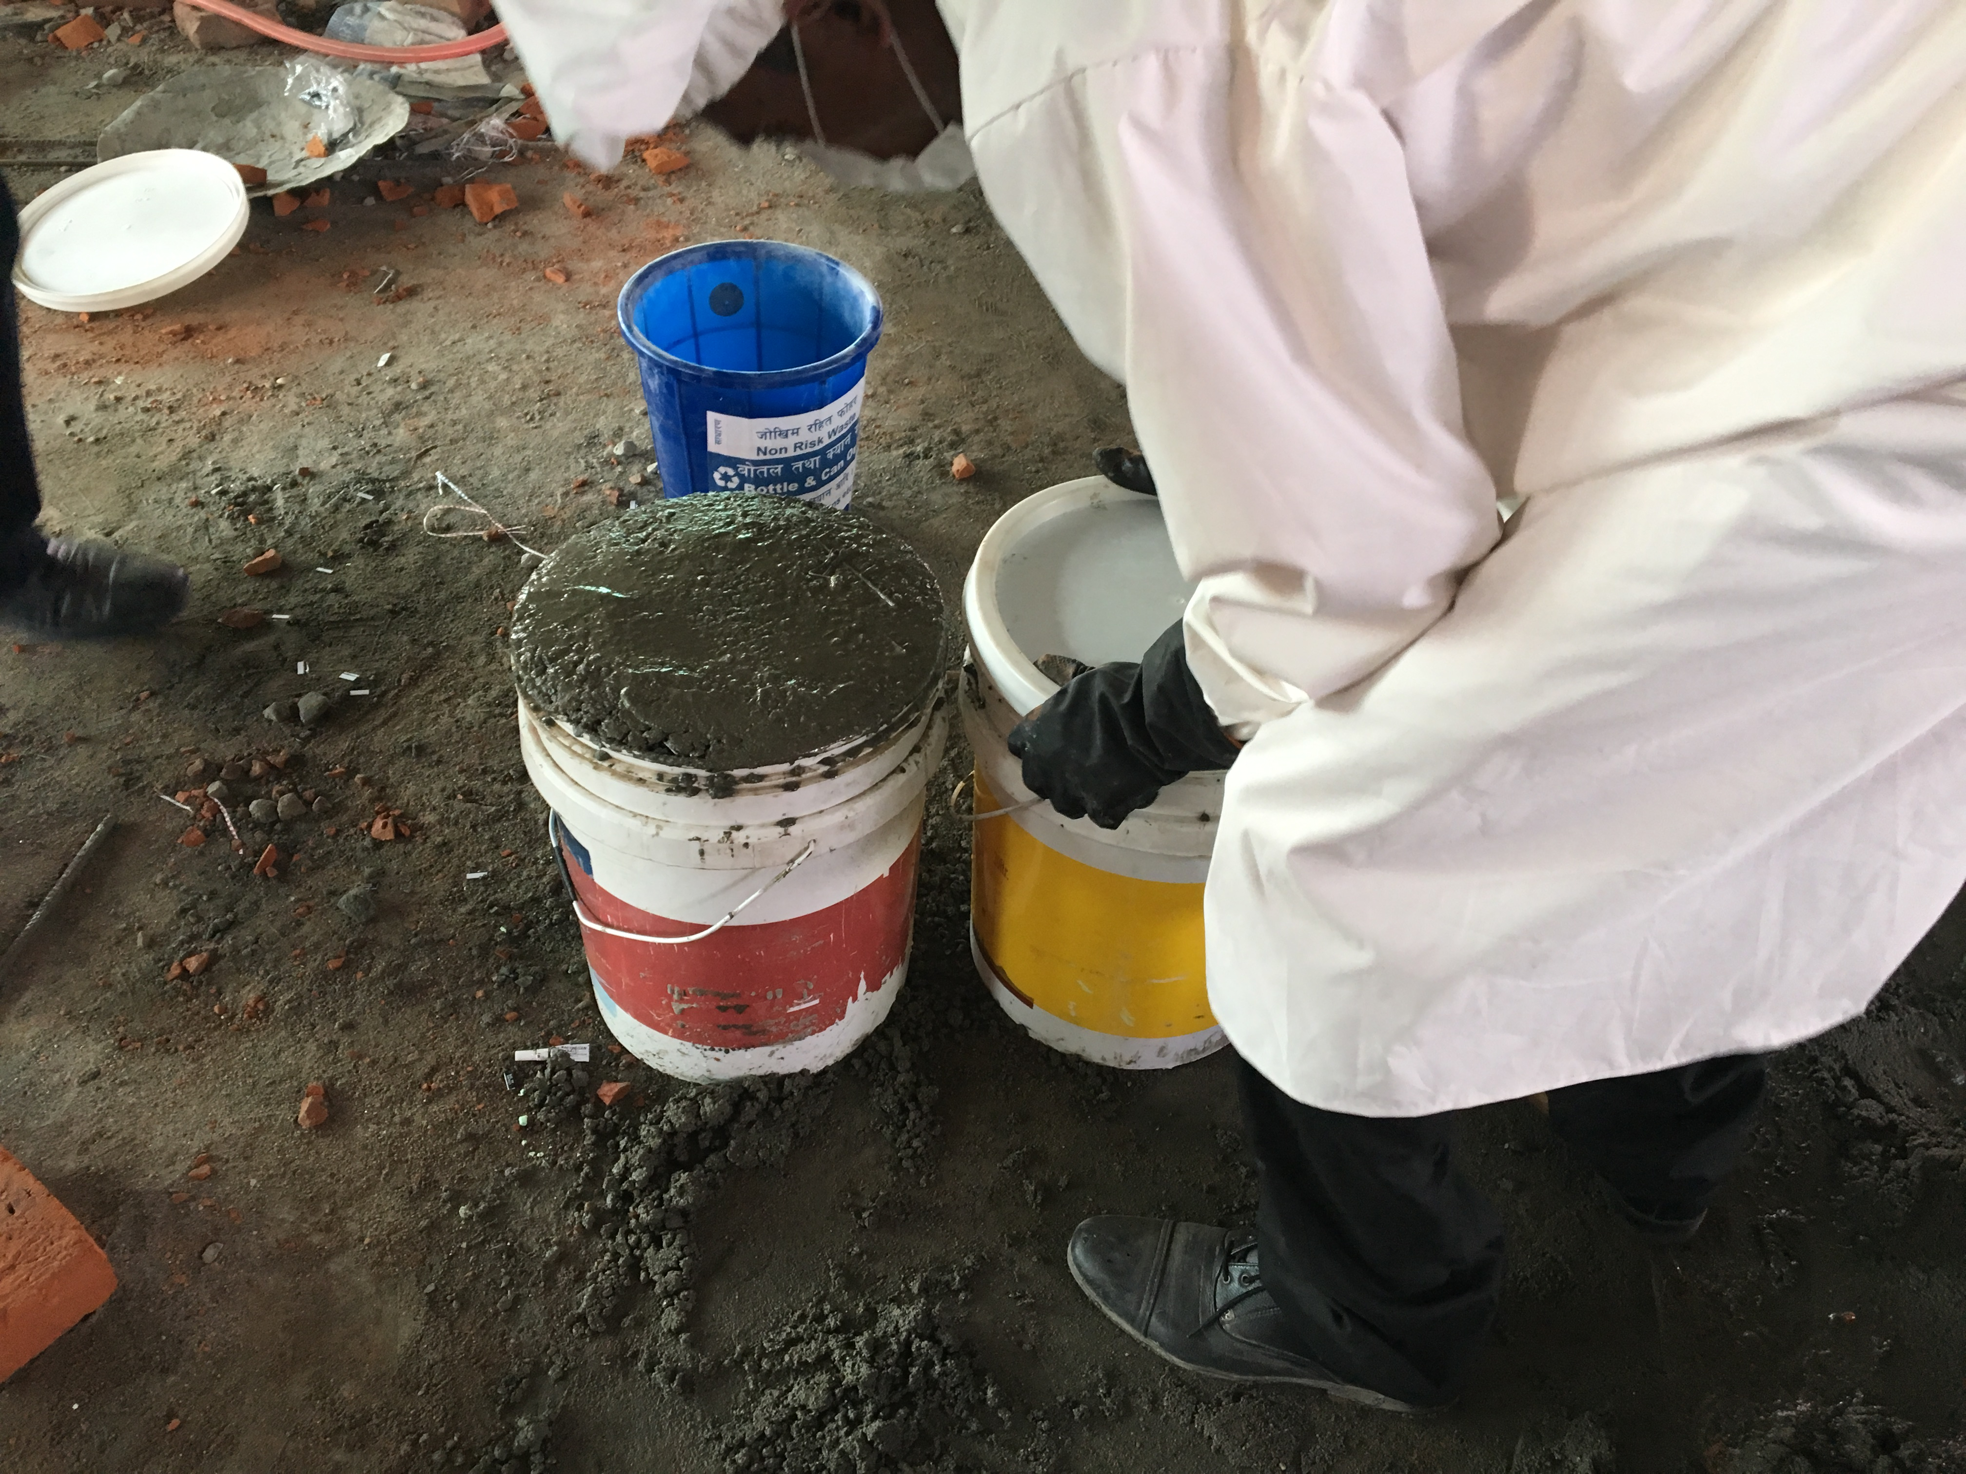
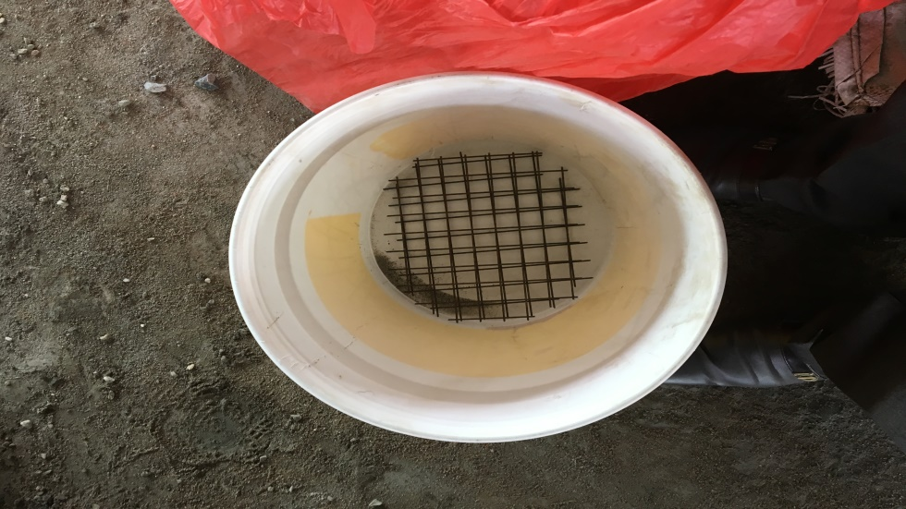
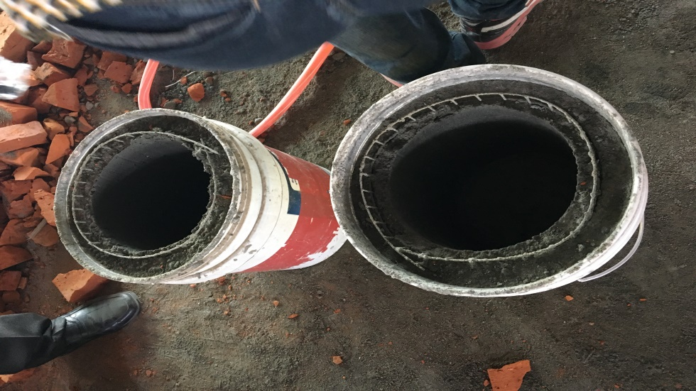
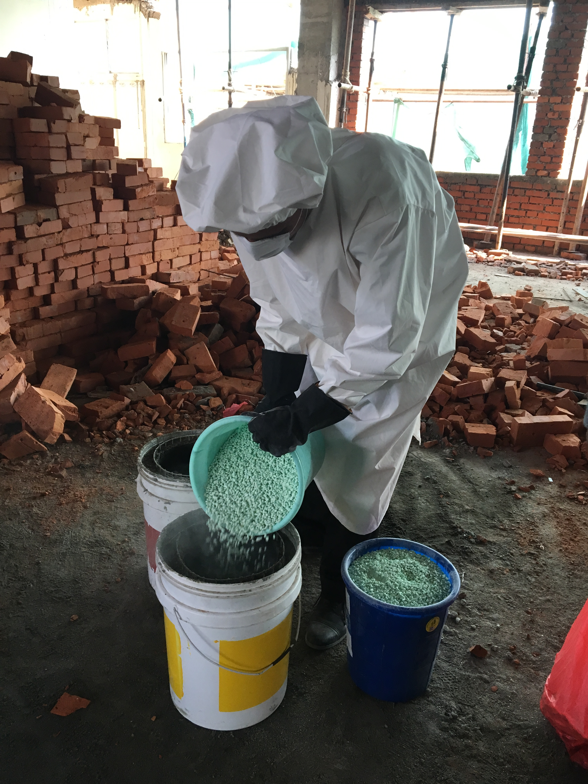
Encapsulation

Slide 40
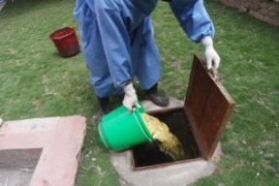
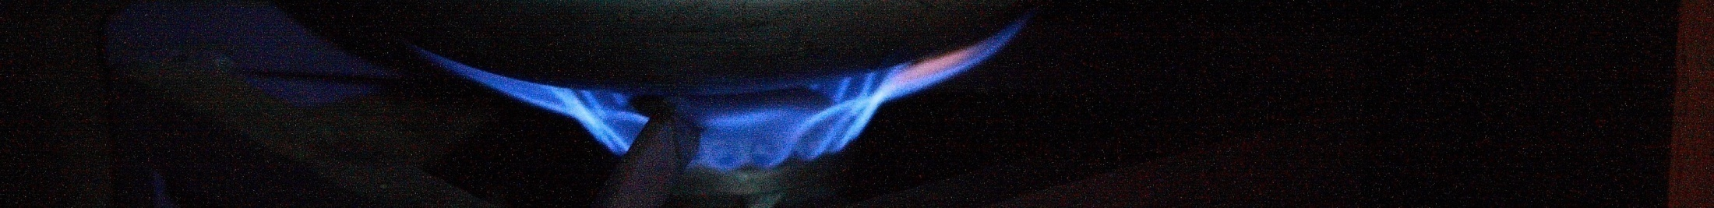
Anaerobic Digestion?
Also known as biogas technology.
Decomposition of organic matter in the absence of oxygen.

Slide 41
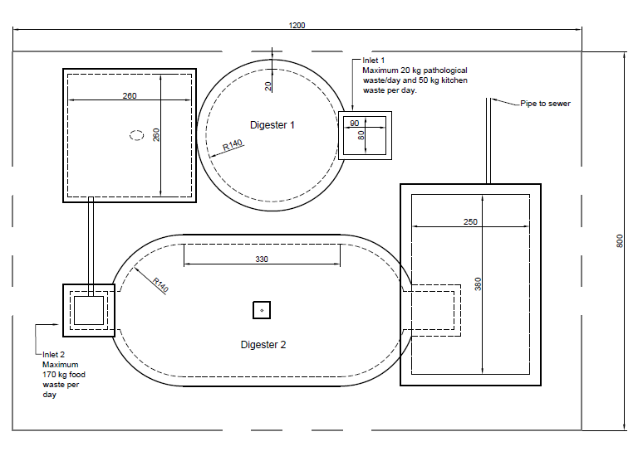
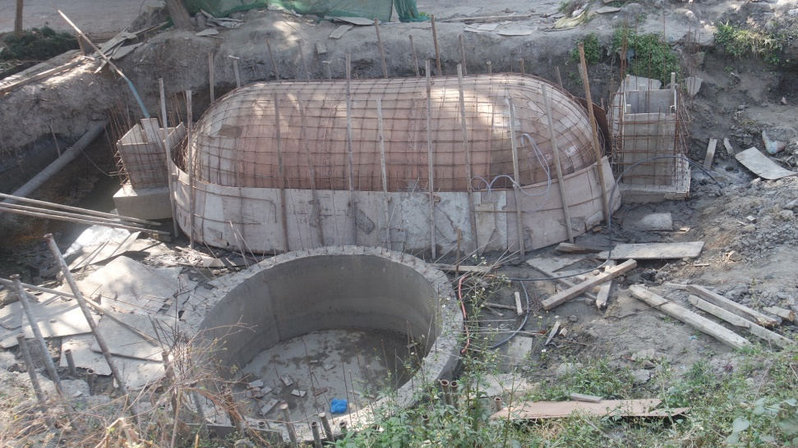
Biogas plant design
  Two chambered to maximize placenta retention time and eliminate pathogens
  Gravitational based system - flow of waste from one chamber to another chamber
:
Kitchen and food waste
Soft pathological waste

Slide 42
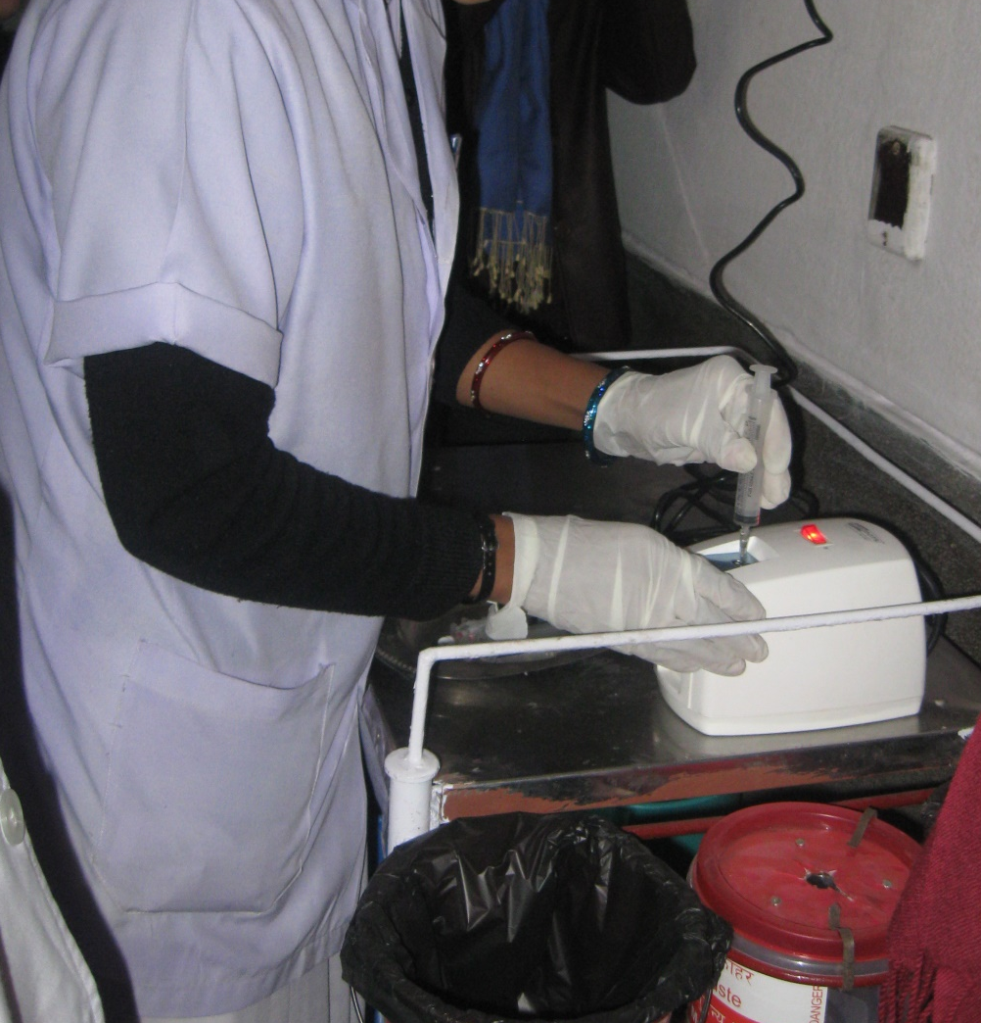
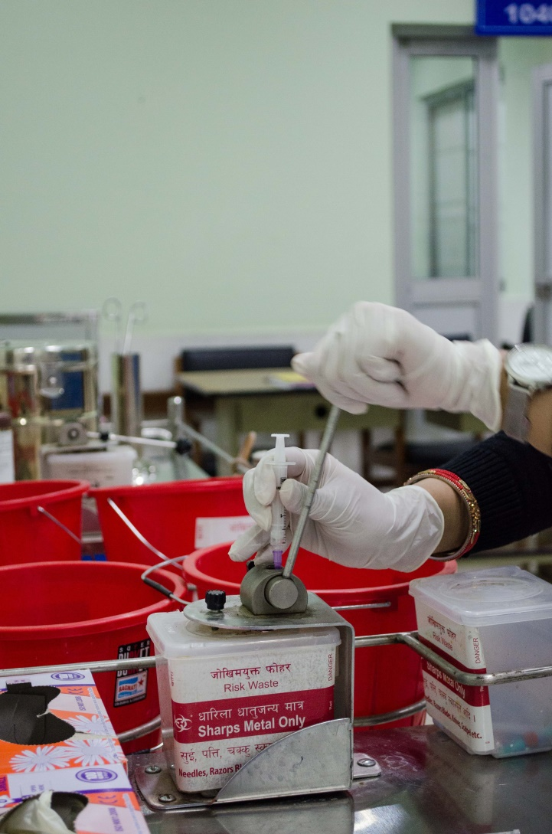
Burn vs. Non Burn Sharps Mangement

